Slide 1
FULL STACK DEVELOPMENT
Year: 2023-24
Semester: 3 Course Code: 23CS2305
Module 1
Markup Language (HTML5): Introduction to HTML and HTML5 - Formatting and Fonts -Commenting Code – Anchors – Backgrounds – Images – Hyperlinks – Lists – Tables – HTML Forms, Audio ,Video Tag

Slide 2
INTRODUCTION
HTML stands for Hyper Text Markup Language.
HTML is the standard markup language for creating web pages.
Markup languages are computer languages used to structure, format, or define relationships between different parts of text documents using symbols or tags.
Markup is used to control the display of the document.
HTML describes the structure of a web page.

Slide 3
SYSTEM REQUIREMENTS
Text Editor
Notepad - Windows
Notepad++ - Windows
TextEdit – Mac
Web Browser
Mozilla Firefox
Google Chrome
Microsoft Edge
Safari

Slide 4
HTML PAGE STRUCTURE
<!DOCTYPE html> <html> <head> <title>Page Title</title> </head> <body> </body> </html>

Slide 5
HTML PAGE STRUCTURE
<!DOCTYPE html>
Defines that the document is an HTML5 document.
<html>
Root element of an HTML page. Defines the whole HTML document.
<head>
Contains meta information about the HTML page.
<body>
Container for visible content.

Slide 6
HTML ELEMENT
Element
The HTML element is everything from the start tag to the end tag.
<tagname>content</tagname>.
Elements can have attributes.
Attributes provide additional information about the elements.
Always specified in the start tag.
Come in name /value pairs: name = “value”
Empty Element
Elements with no content.
Do not have an end tag.
Nested HTML Elements
Elements can contain other elements.

Slide 7
NOTE
HTML tags are not case sensitive. Recommended to use lowercase in HTML.
Never skip the end tag.
Recommended to use quotes around attribute values.
Double quotes around attribute values are the most common.
Single quotes can also be used.
When attribute value itself contains double quotes, it is necessary to use single quotes.

Slide 8
FIRST HTML PAGE – OPEN TEXT EDITOR
Windows
Open the Start Screen. Type Notepad. Click to open.
Mac
Open Finder > Applications > TextEdit
In Preferences > Format > Plain Text.
Under Open and Save, check the box that says "Display HTML files as HTML code instead of formatted text".
Open the new document.

Slide 9
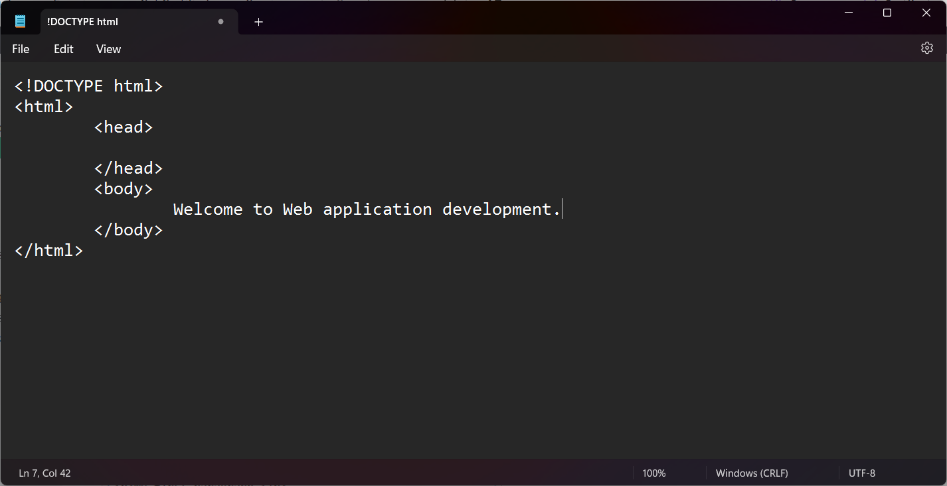
FIRST HTML PAGE – WRITE HTML

Slide 10
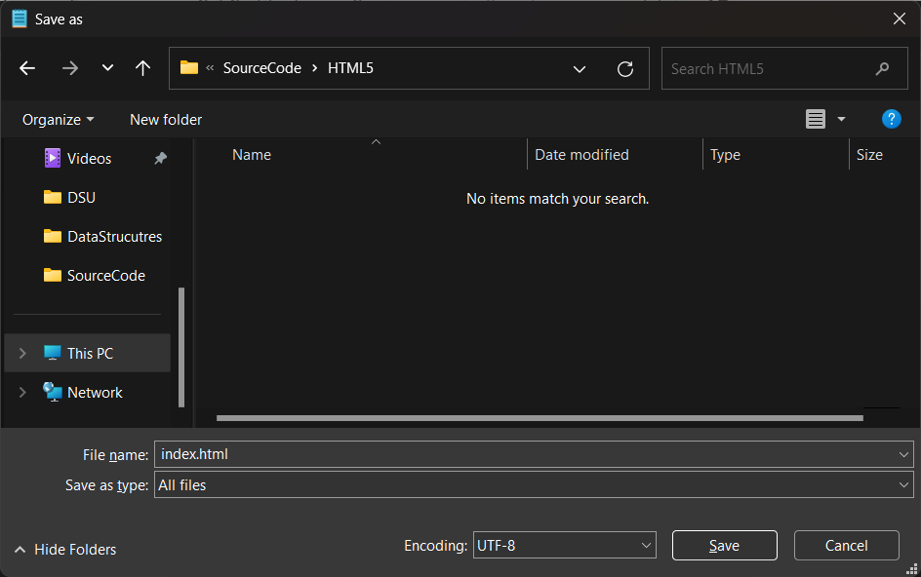
FIRST HTML PAGE – SAVE THE FILE
Create a folder Workspace > HTML.
Select File > Save as.
File extension can be .html or .htm

Slide 11
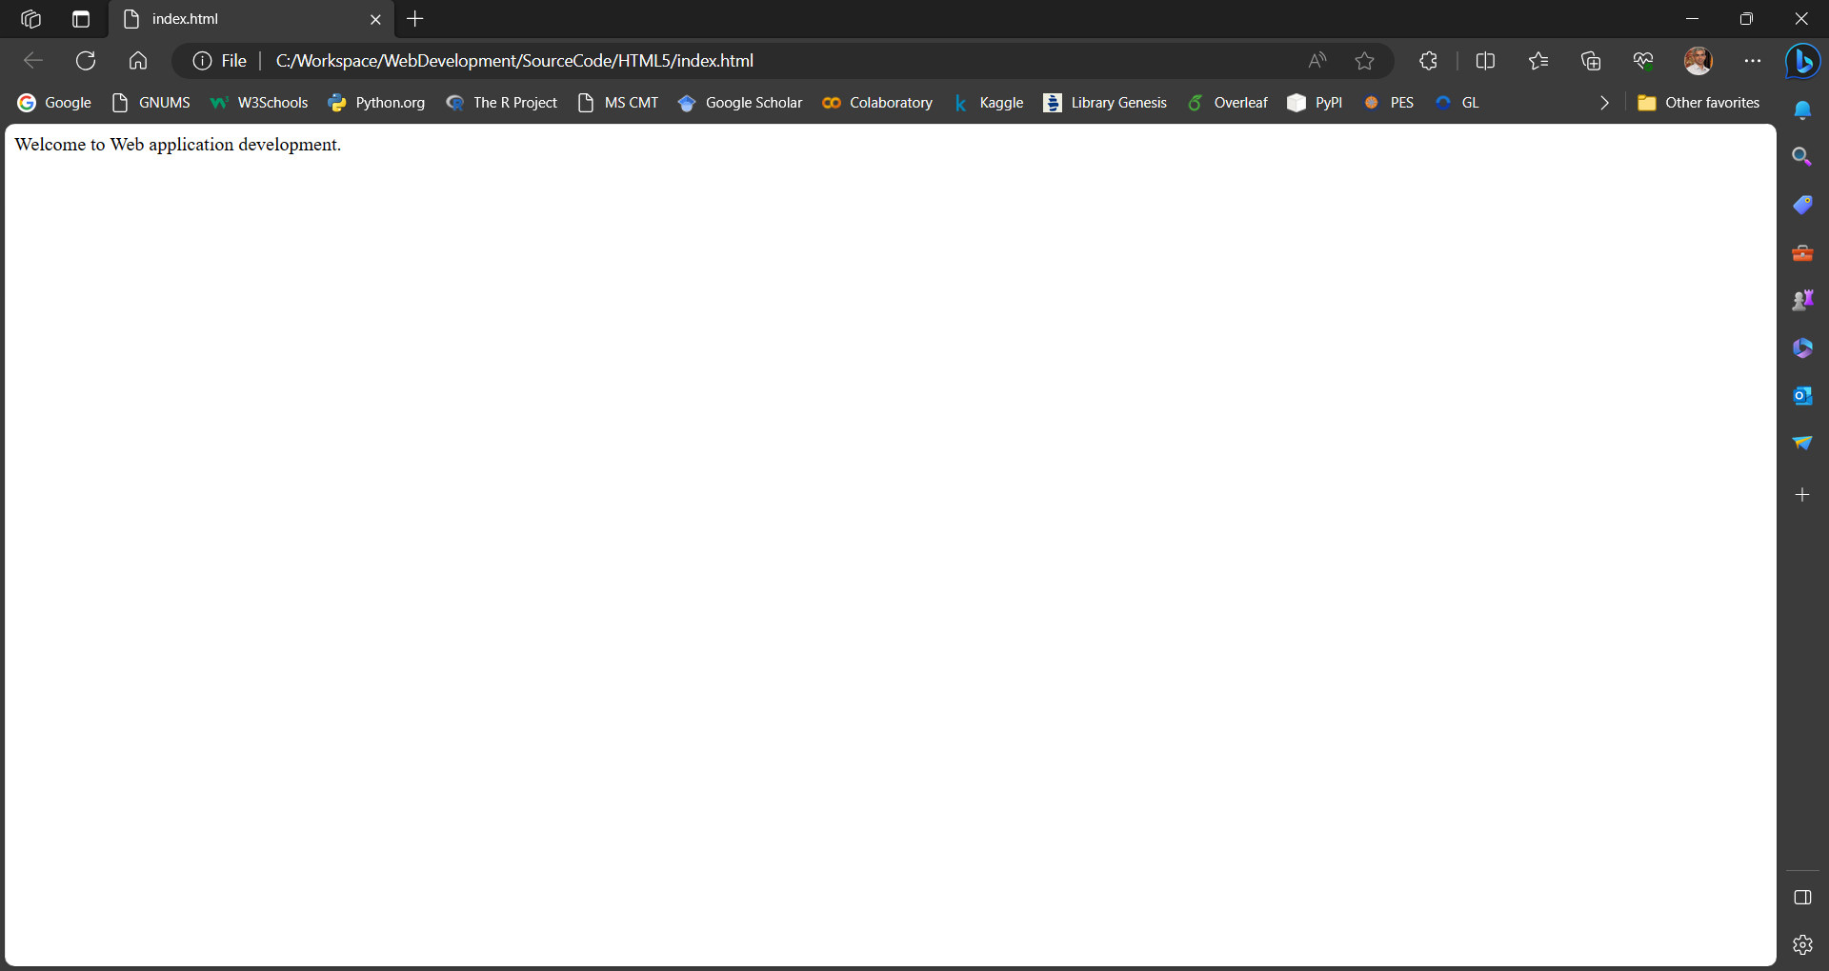
FIRST HTML PAGE – VIEW IN BROWSER
Double click on the .html/.htm file OR right-click > Open with

Slide 12
HTML HEADINGS
Headings are titles or subtitles to be displayed on a web page.
HTML headings are defined with <h1> to <h6> tags.
<h1> defines the most important heading.
<h1> to be used for main heading followed by <h2>, <h3>, <h4>, ,h5> and <h6>.
<h6> defines the least important heading.
Browser adds a margin before and after a heading.
Search engines use headings to index the structure and content of the web pages.
Each HTML heading has a default font size and can be changed using CSS.
Don’t use HTML heading to make text Big or bold.

Slide 13
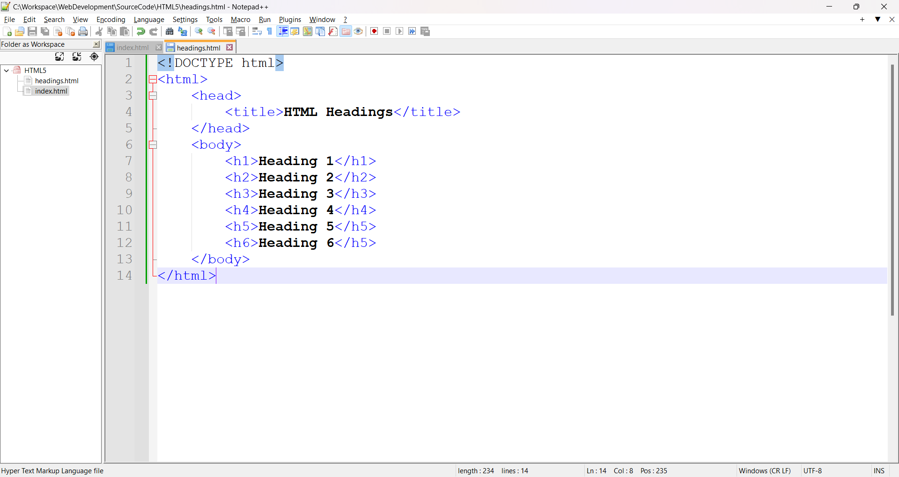
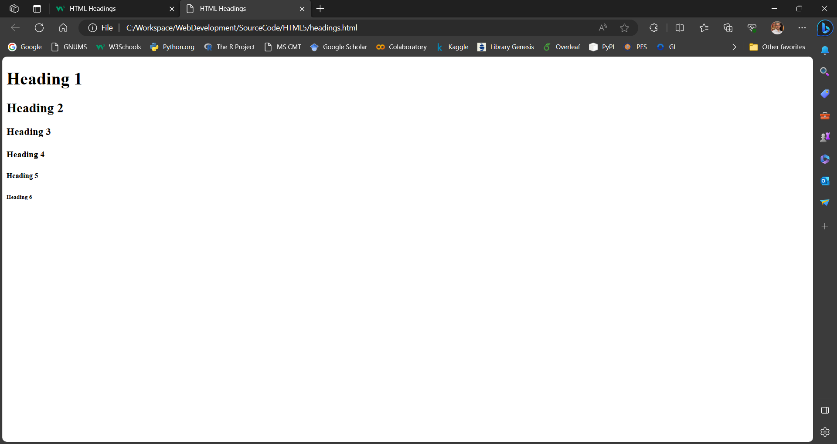
HTML HEADINGS

Slide 14
HTML PARAGRAPHS
A paragraph is a block of text and always starts on a new line.
<p> element defines a paragraph.
Web browser adds a margin before and after a paragraph.

Slide 15
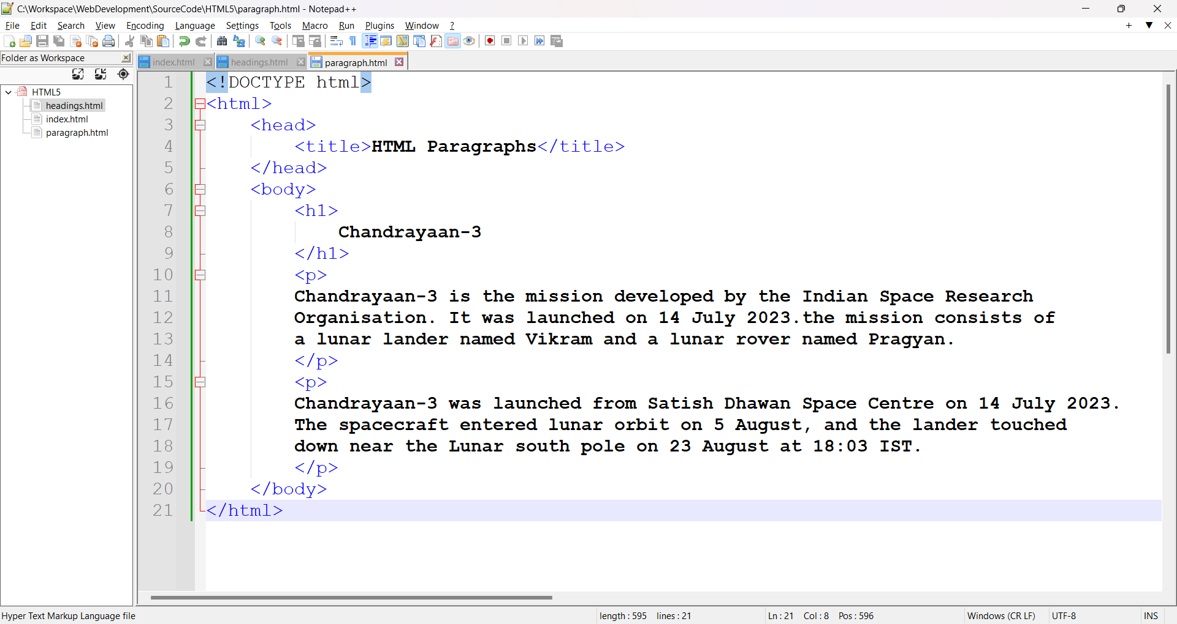
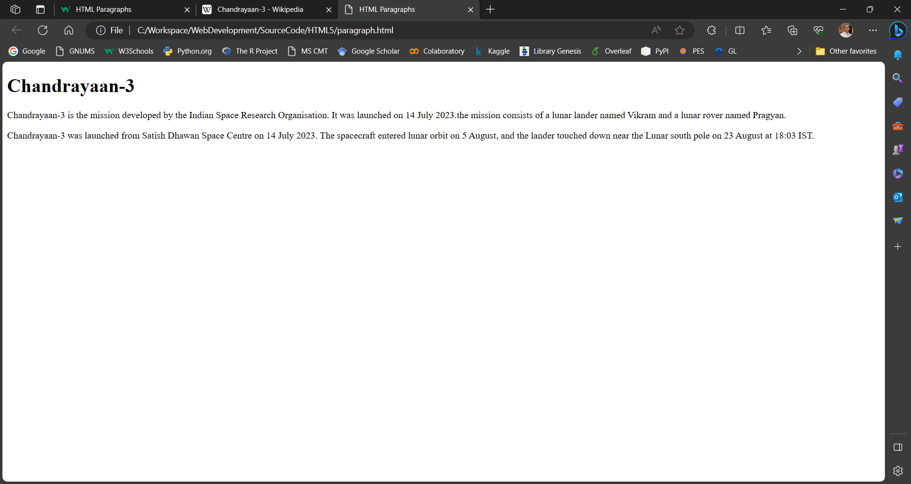
HTML PARAGRAPHS

Slide 16
HTML DISPLAY
We can’t be sure how HTML will be displayed.
Large or small screens, and resized windows will create different results.
Display can’t be changed by adding extra spaces or extra lines in the HTML code. The browser automatically removes any extra spaces and lines when displaying.

Slide 17
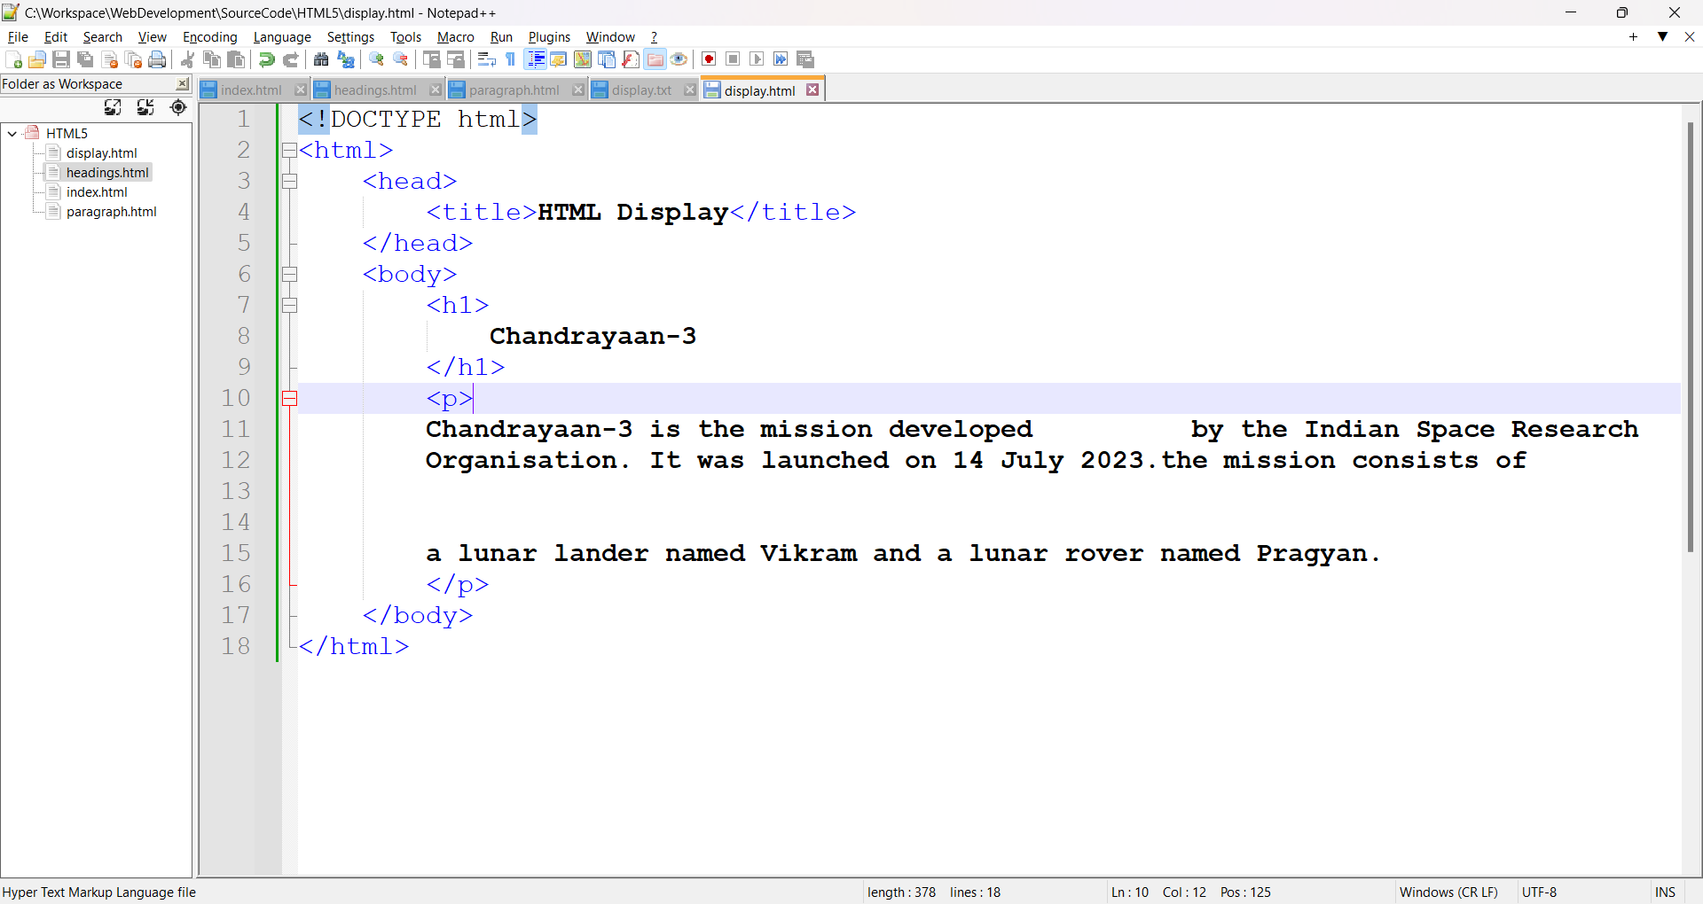
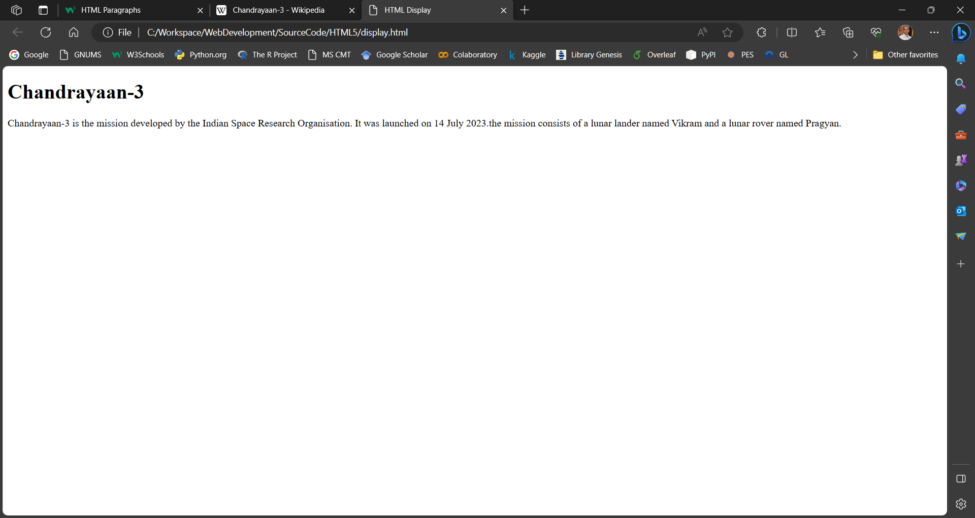
HTML DISPLAY

Slide 18
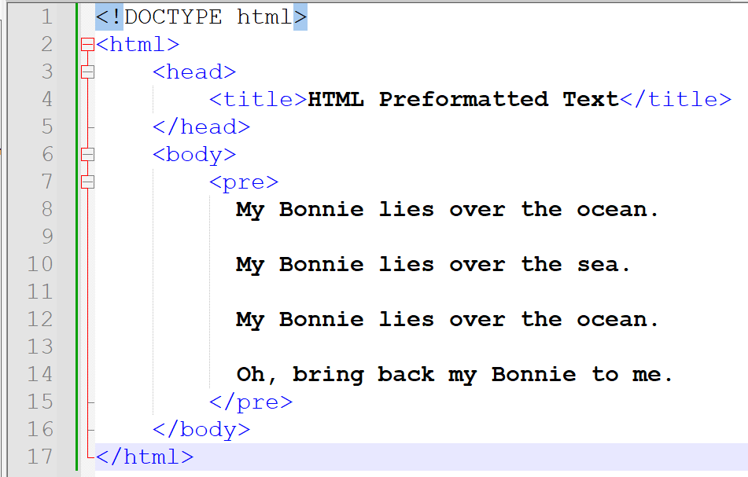
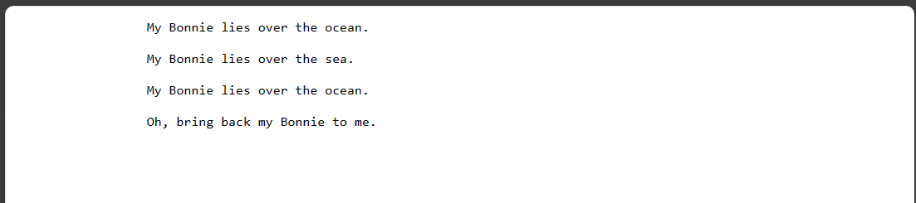
PREFORMATTED TEXT
The <pre> element defines the preformatted text.
The element preserves both spaces and line breaks.

Slide 19
HTML HORIZONTAL RULES
<hr> element is used to display a horizontal rule.
It is used to separate content in an HTML page.

Slide 20
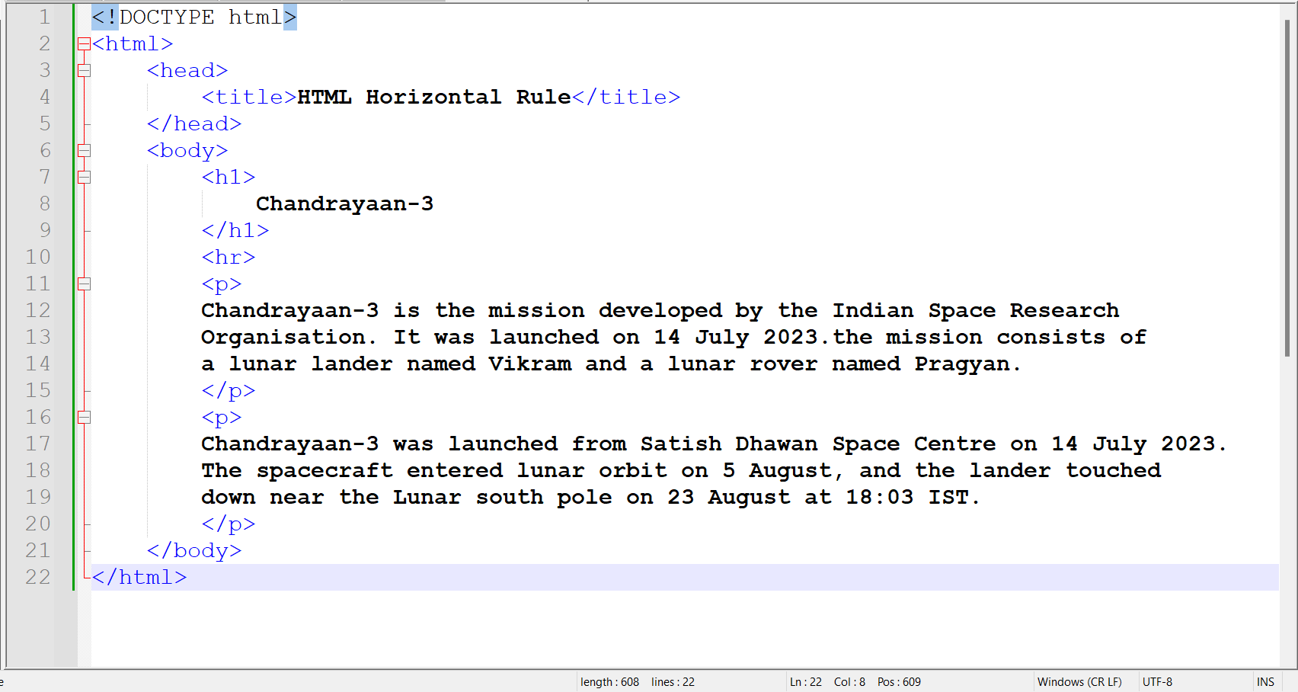
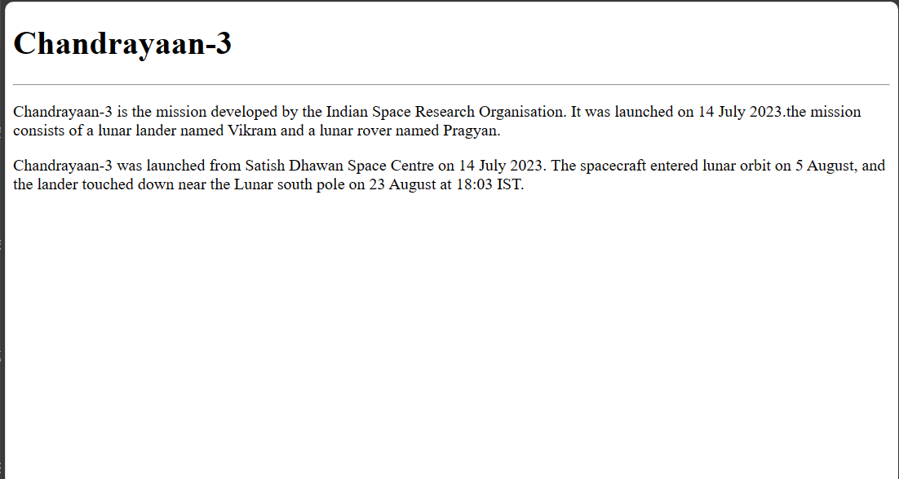
HTML HORIZONTAL RULES

Slide 21
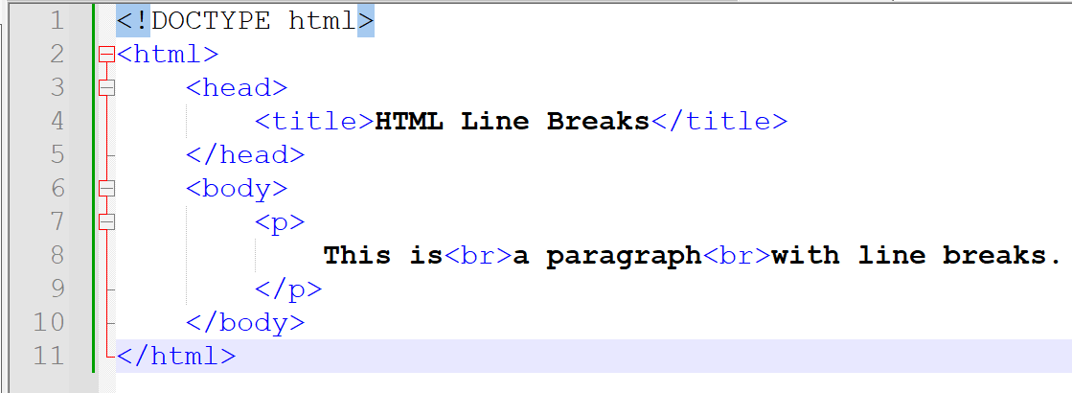
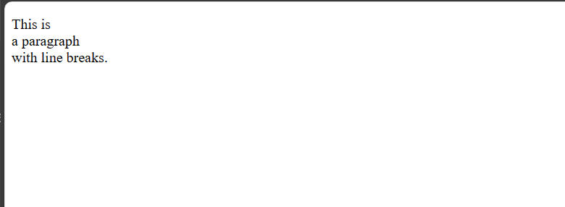
HTML LINE BREAKS
The <br> element defines a line break (a new line), without starting a new paragraph.

Slide 22
HTML TEXT FORMATTING
To display special type of text.
<b> to display bold text.
<strong> to display important text.
<i> to display italic text.
<em> to display emphasized text.
<mark> to display marked text.
<small> to display smaller text
<del> to display deleted text.
<ins> to display inserted text.
<sub> to display subscript text.
<sup> to display superscript text.

Slide 23
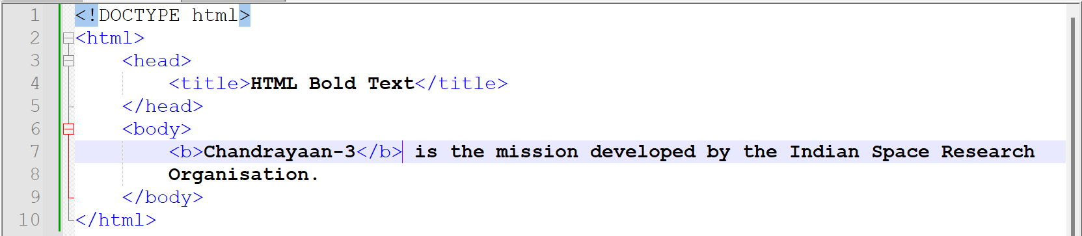
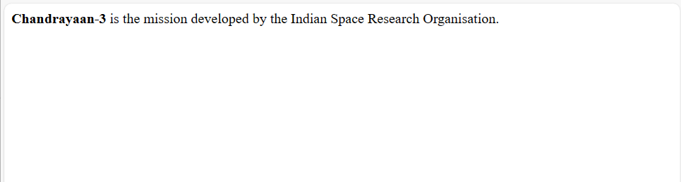
HTML TEXT FORMATTING – BOLD TEXT
The HTML <b> element defines the bold text.
No additional importance to the text.

Slide 24
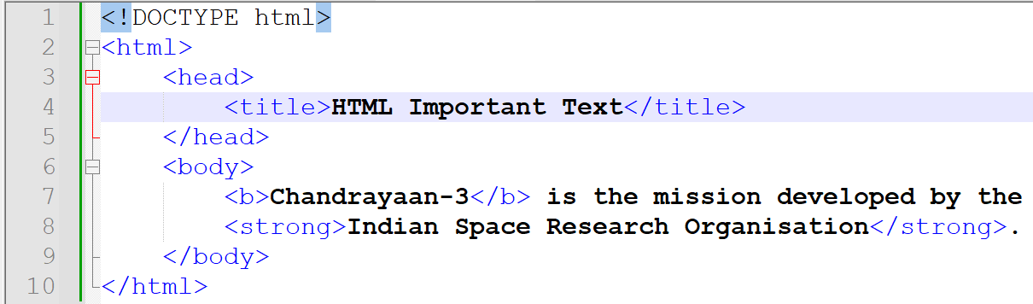
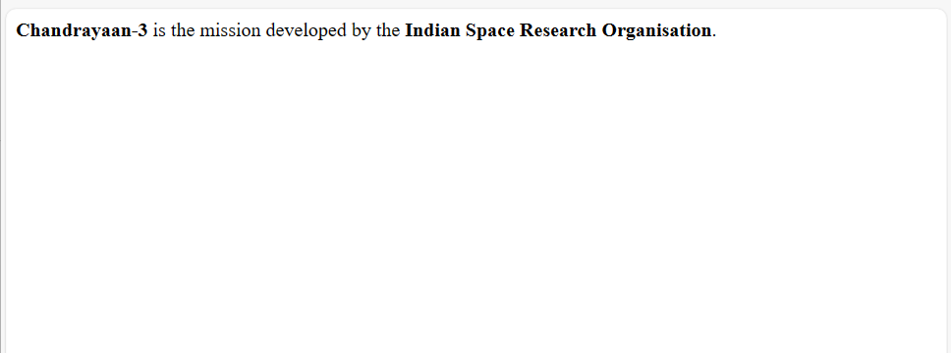
HTML TEXT FORMATTING – IMPORTANT TEXT
The HTML <strong> element defines the text with strong importance.
The text is displayed in bold.

Slide 25
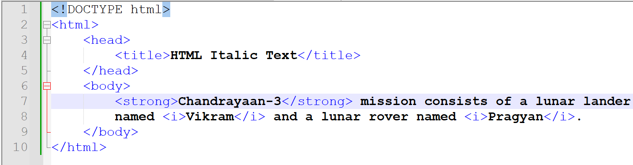
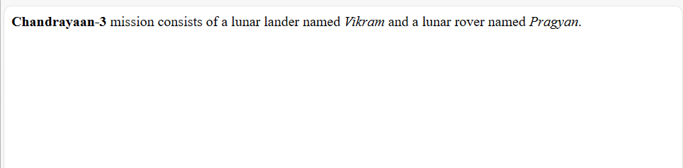
HTML TEXT FORMATTING – ITALIC TEXT
The HTML element <i> defines the italic text.
It defines the text in alternate voice or mood.

Slide 26
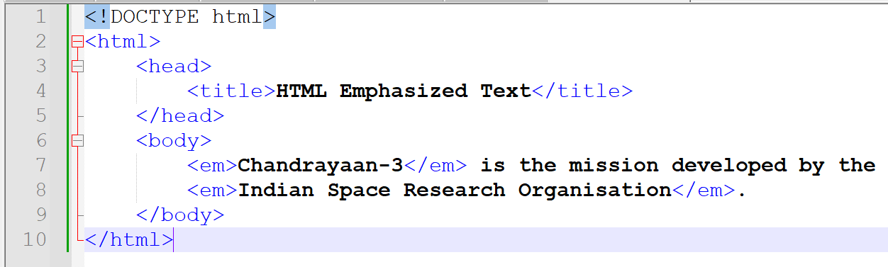
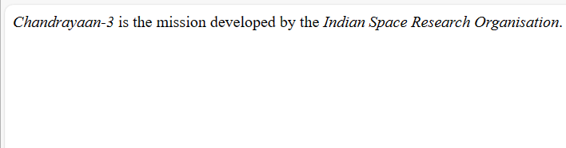
HTML TEXT FORMATTING – EMPHASIZED TEXT
The HTML <em> element defines the emphasized text.
The text is displayed in italic.
A screen reader will pronounce the words in <em> with an emphasis, using verbal stress.

Slide 27
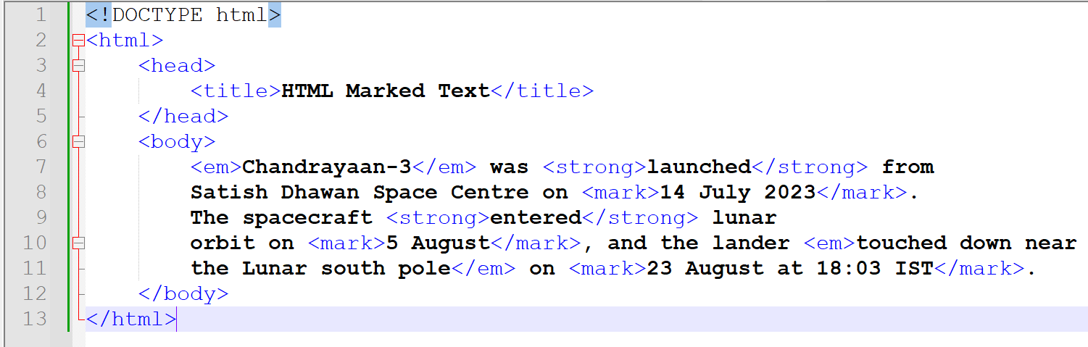
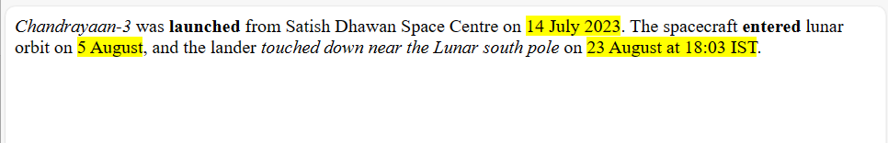
HTML TEXT FORMATTING – MARKED TEXT
The HTML element <mark> defines the text that is marked or highlighted.

Slide 28
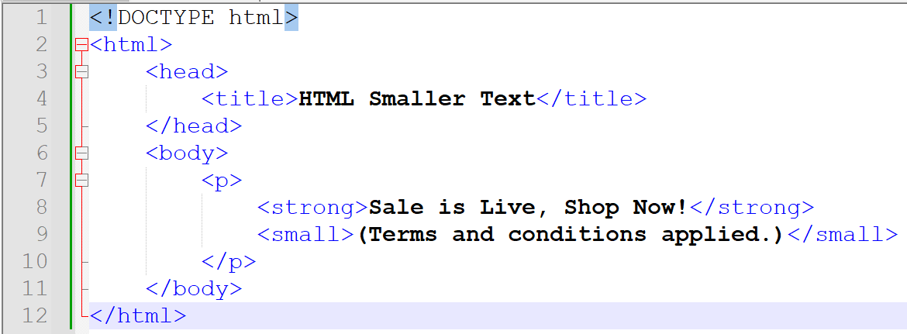
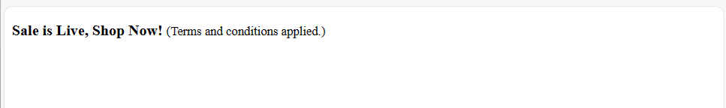
HTML TEXT FORMATTING – SMALLER TEXT
The HTML <small> element defines the small text.
It is used to make the text one font size smaller (from medium to small, from x-large to large).
Used to mark up cautions, legal restrictions, disclaimers, copyright notice or license agreement.

Slide 29
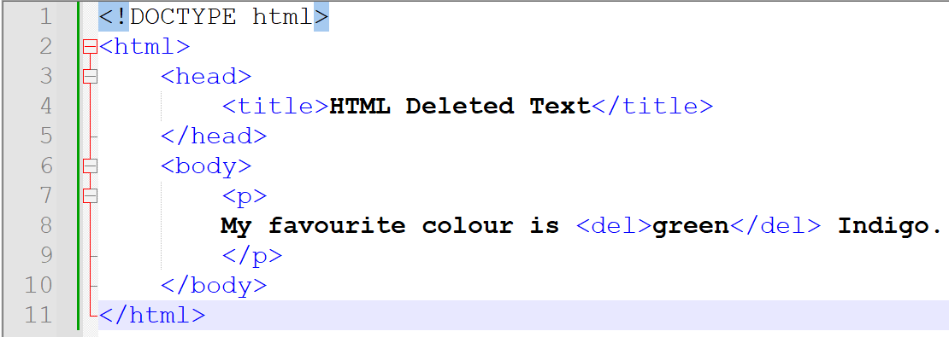
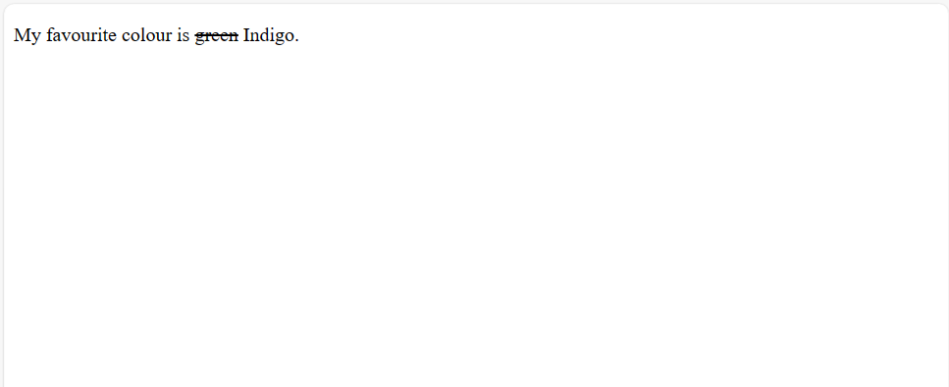
HTML TEXT FORMATTING – DELETED TEXT
The HTML <del> element defines the text deleted from a document.
Browser strike a line through the deleted text.

Slide 30
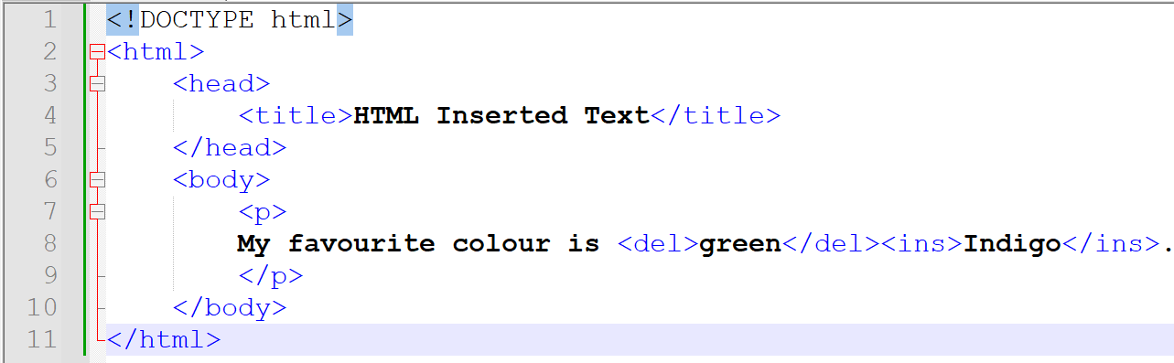
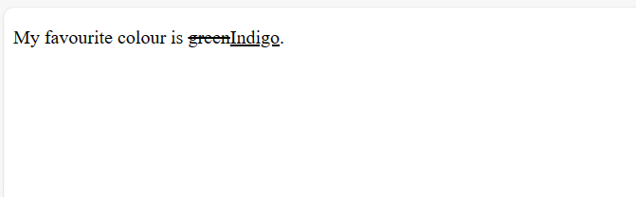
HTML TEXT FORMATTING – INSERTED TEXT
The HTML <ins> element defines the text that has been inserted into a document.
Browser underline the inserted text.

Slide 31
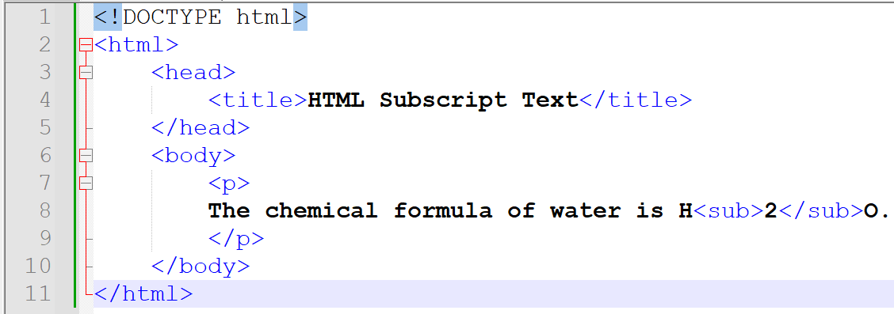

HTML TEXT FORMATTING – SUBSCRIPT TEXT
The HTML <sub> element defines the subscript text.
Subscript text appears half a character below the normal line.
Subscript text is sometimes rendered in a smaller font.

Slide 32
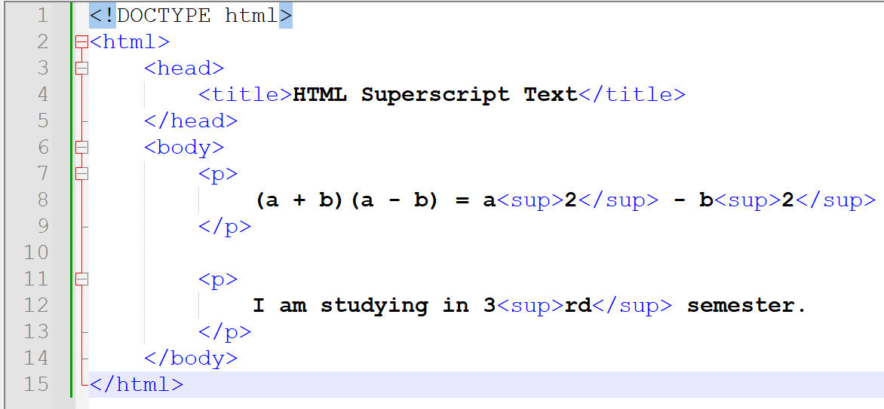
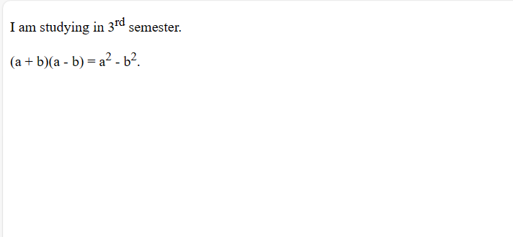
HTML TEXT FORMATTING – SUPERSCRIPT TEXT
The HTML <sup> element defines superscript text.
Superscript text appears half a character above the normal line and sometimes rendered in a smaller font.
Used to display exponent, ordinal numbers.

Slide 33
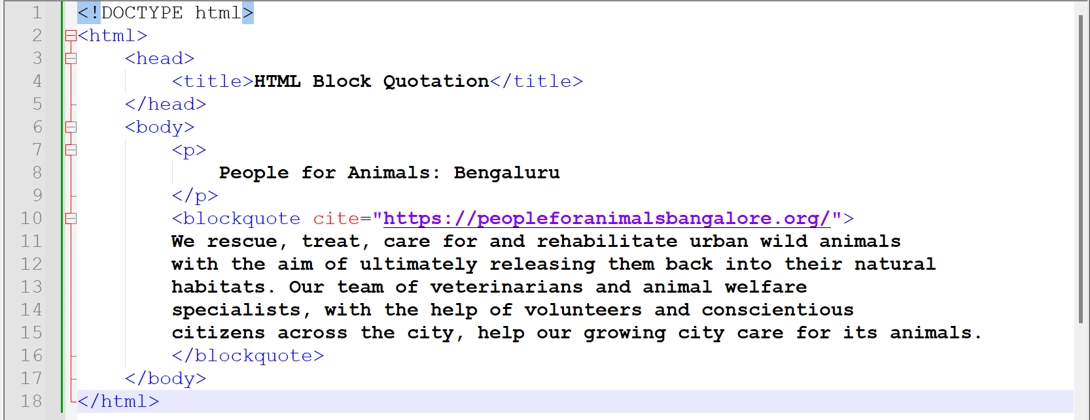
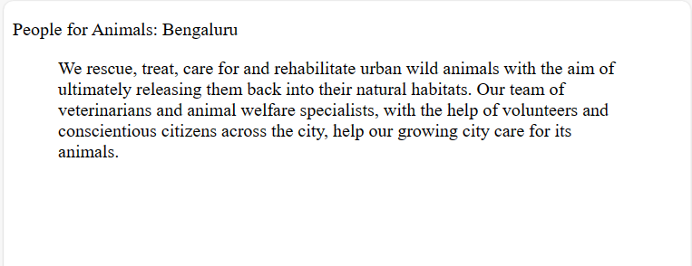
HTML QUOTATION AND CITATION ELEMENTS
The HTML <blockquote> element defines a section that is quoted from another source.
Usually browsers indent the <blockquote> elements.

Slide 34
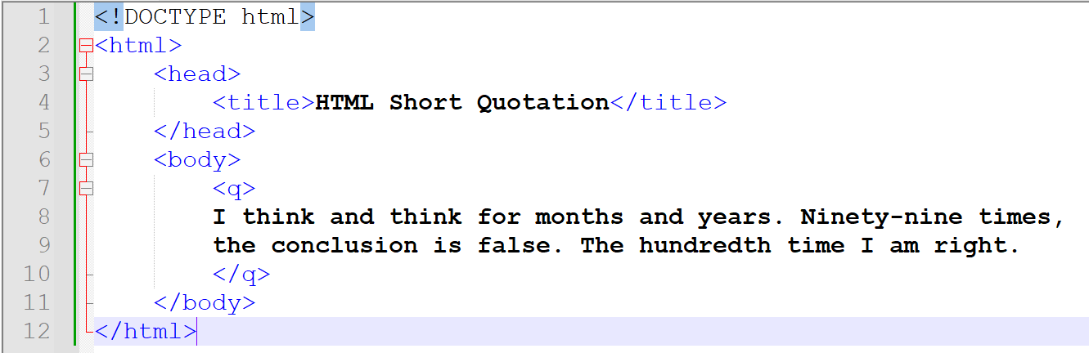
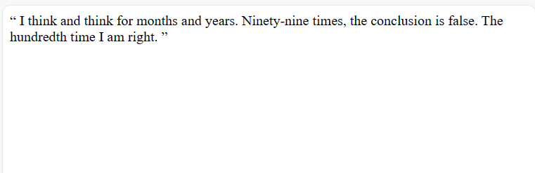
HTML QUOTATION AND CITATION ELEMENTS
The HTML <q> element defines a short quotation.
Browsers normally insert quotation marks around the quotation.

Slide 35
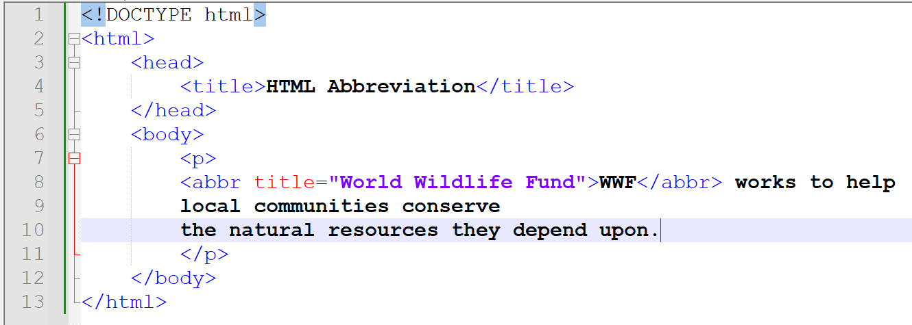
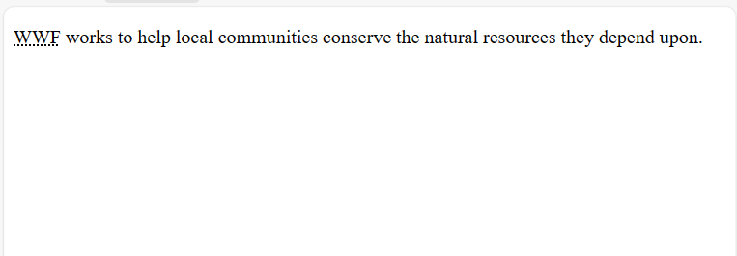
HTML QUOTATION AND CITATION ELEMENTS
The HTML <abbr> element defines the abbreviation or acronym.
Use the global title attribute to show the description for the abbreviation/acronym.

Slide 36
HTML QUOTATION AND CITATION ELEMENTS
The HTML <address> element defines the address for the author/owner of a document or article.
The contact information can be an email, URL, physical address, phone number social media handle etc.
The text is usually rendered in italic, and the browser always add a line break before and after the <address> element.

Slide 37
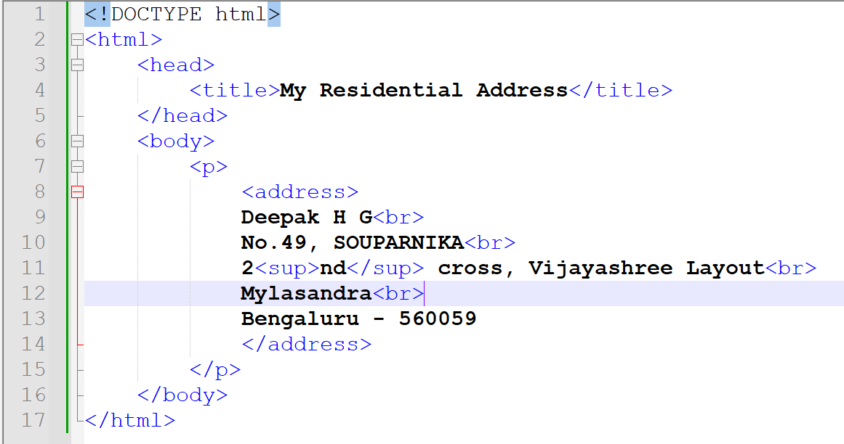
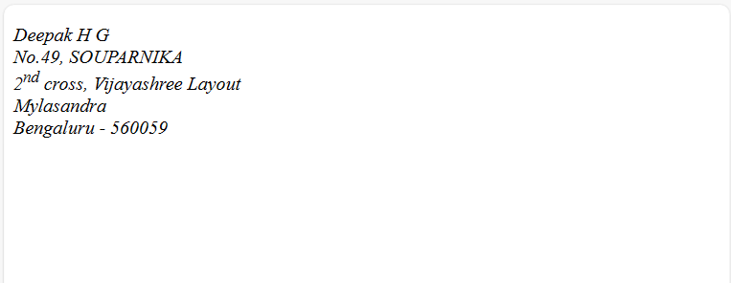
HTML QUOTATION AND CITATION ELEMENTS

Slide 38
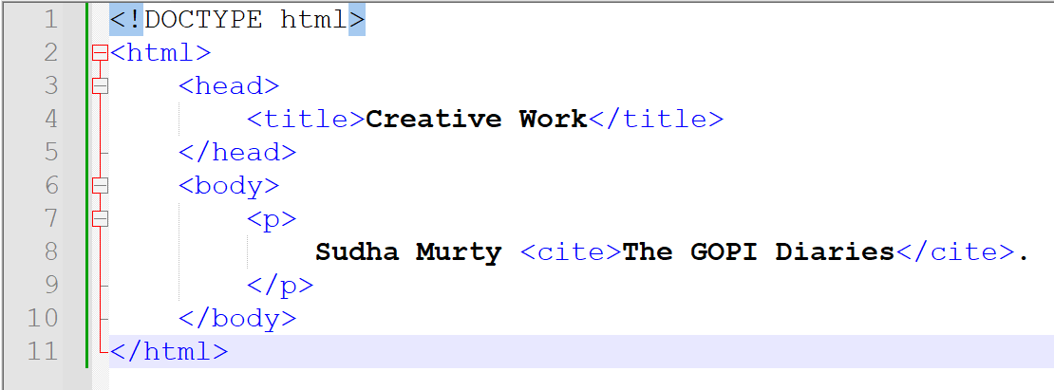
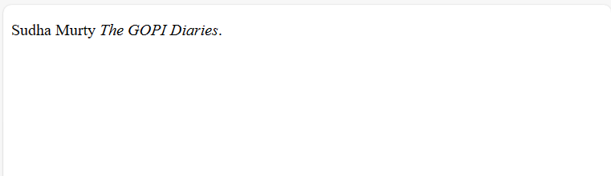
HTML QUOTATION AND CITATION ELEMENTS
The HTML <cite> defines the title of a creative work like a book, a poem, a song etc..
The text in the <cite> element is rendered in italic.

Slide 39
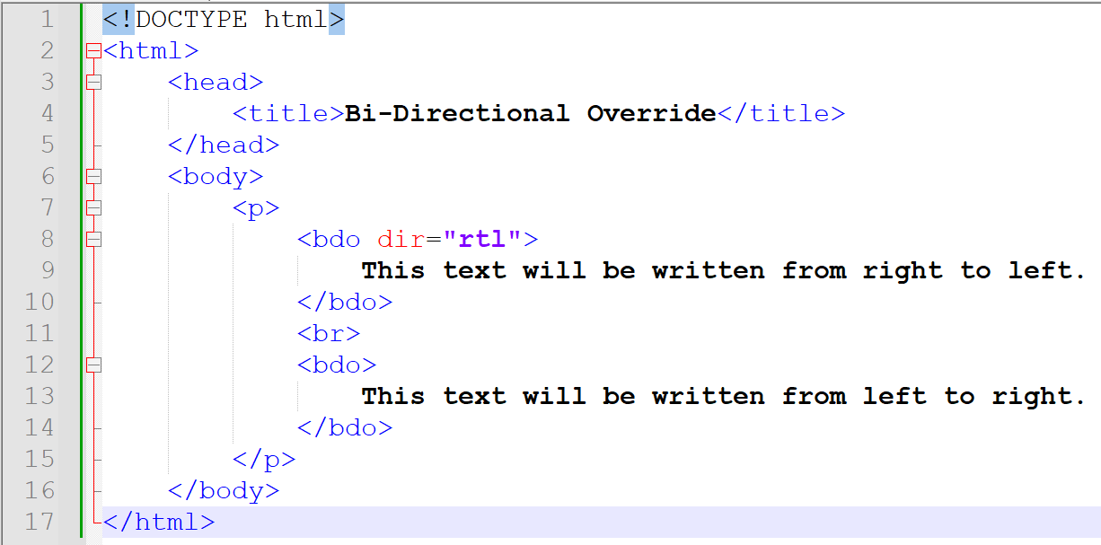
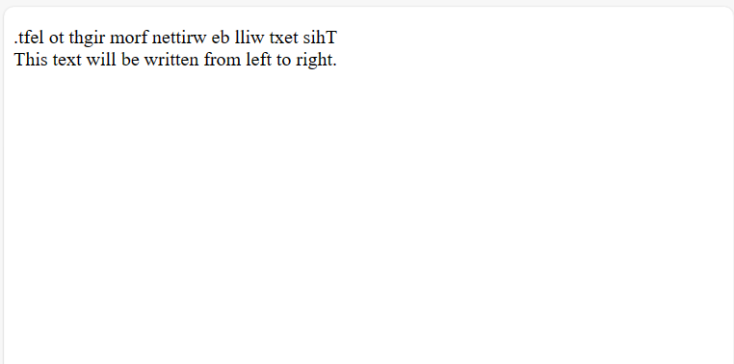
BI-DIRECTIONAL OVERRIDE
The HTML <bdo> element is used to override the current text direction.
BDO stands for Bi-Directional Override.

Slide 40
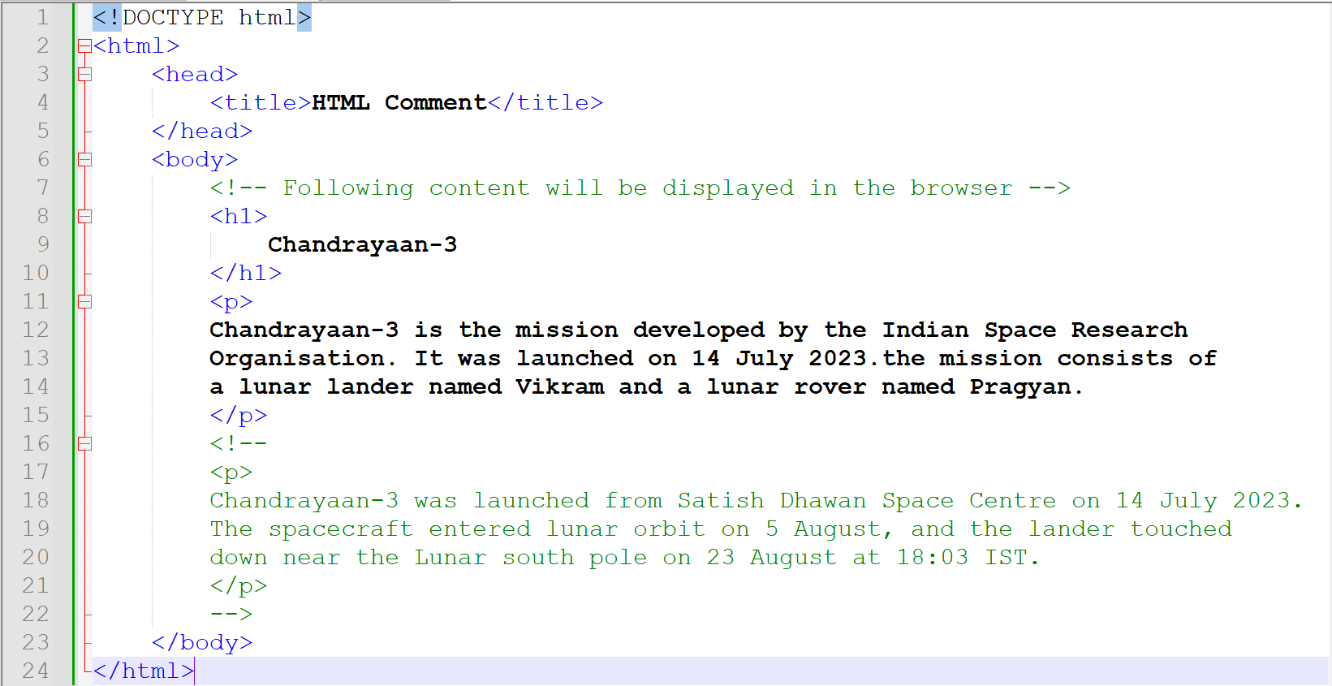
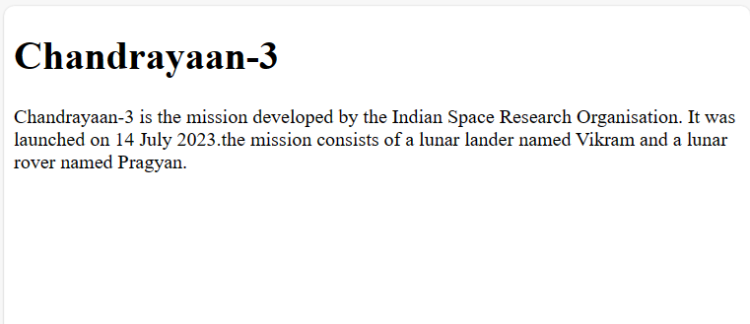
HTML COMMENTS
HTML comments help to document the HTML source code.
HTML comments are not displayed in the browser.

Slide 41
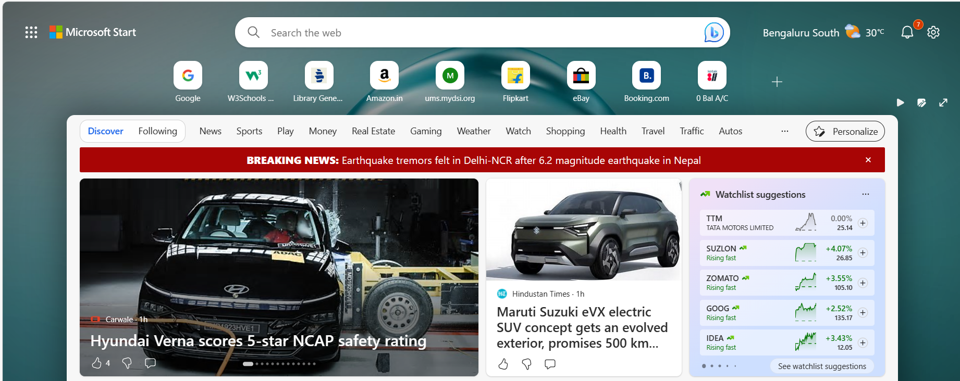
HTML LINKS - HYPERLINKS
An hyperlink is an interface to navigate from one document/web site to another.
User need to click the link for navigation.
When the mouse is moved over a link, the mouse arrow turns into a little hand.
A link can be any HTML element. Need not be a text or image.

Slide 42
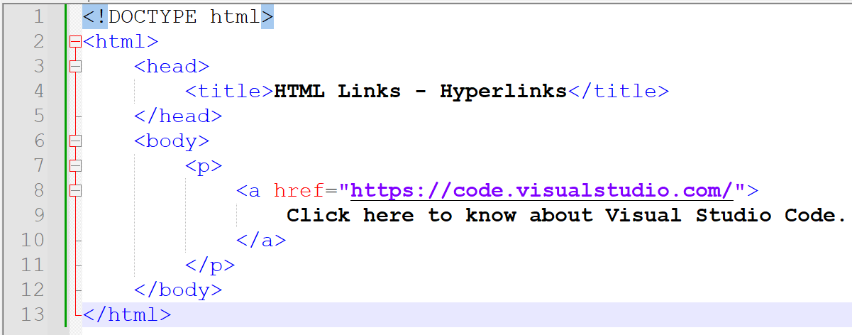

HTML LINKS - HYPERLINKS
The HTML <a> element defines a hyperlink.
The most important attribute of the <a> element is href. It indicates the link’s destination.

Slide 43



HTML LINKS - HYPERLINKS
Appearance of a link in the browser
An unvisited link is underlined and blue.
A visited link is underlined and purple.
An active link is underlined and red.
An active link is a hyperlink that is currently being interacted with the user.

Slide 44
HTML LINKS - HYPERLINKS
The target attribute:
By default, the linked document. is displayed in the current browser.
The target attribute specifies where to open the linked document.
The target attribute can have the following values:
_self – Default. Opens the linked document in the current window or tab.
_blank – Opens the linked document in a new window or tab.
_parent – Opens the linked document in the parent frame.
_top – Opens the linked document in the full body of the window.

Slide 45

HTML LINKS - HYPERLINKS

Slide 46
HTML LINKS - HYPERLINKS
URLs
Address indicating the location of a file or resource on the World Wide Web.
Absolute URL
The complete address of the document on the internet.
Relative URL
Address of the document relative to the current document or directory.

Slide 47

HTML LINKS - HYPERLINKS

Slide 48


HTML LINKS – LINK TO AN EMAIL ADDRESS
Use the mailto: inside the href attribute to create a link that opens the user’s email program.
This lets the user to send an email.

Slide 49


HTML LINKS – LINK TO AN EMAIL ADDRESS

Slide 50
HTML IMAGES
The HTML <img> tag is used to attach an image in a web page.
Loading large images takes time, and can slow down the web page. Use images carefully.
The <img> tag has 2 required attributes:
src – To specify the path (URL) to the image
alt – To specify an alternate text for the image, if image is not displayed for some reason.

Slide 51




HTML IMAGES

Slide 52
HTML LISTS
Lists refers to collection of items.
Lists are best ways to represent information.
Three ways to represent lists:
Ordered lists
Unordered lists
Description lists

Slide 53
HTML LISTS – UNORDERED LISTS
To represent items that are not in any particular order.
An unordered list starts with <ul> tag. Each list item starts with the <li> tag.
By default, list items will be displayed with bullets.

Slide 54


HTML LISTS – UNORDERED LISTS

Slide 55
HTML LISTS – ORDERED LISTS
To represent items that are in a particular order.
An ordered list starts with <ol> tag. Each list item starts with the <li> tag.
By default, the list items will be numbered.

Slide 56


HTML LISTS – ORDERED LISTS

Slide 57
HTML LISTS – DESCRIPTION LISTS
A description list is a list of items, with a description for each item.
The <dl> tag is used to define the description list.
The <dt> tag is used to define the list item/term.
The <dd> tag is used to describe each item/term.

Slide 58


HTML LISTS – DESCRIPTION LISTS

Slide 59
HTML TABLES
Table is used to organise the data into rows and columns.
A HTML table consists of table cells inside rows and columns.
Name | Physics | Chemistry | Mathematics | Total
Abhishek | 60 | 87 | 59 | 206
Anirudh | 63 | 80 | 45 | 188
Aditi | 55 | 40 | 86 | 181
Prakash | 64 | 90 | 85 | 239

Slide 60
HTML TABLES
The HTML <table> tag is used to create a table.
Each table row starts with a <tr> and ends with a </tr> tag.
tr stands for table row.
Each table cell is defined by a <td> and </td> tag.
td stands for table data.
To define the table cells as header cells, use <th> and </th> tag instead of <td> and </td> tag.

Slide 61


HTML TABLES

Slide 62


HTML TABLES – BORDER ATTRIBUTE

Slide 63


HTML TABLES – TABLE CAPTION
Add a caption that serves as a heading for the entire table.
The HTML <caption> tag is used.
The <caption> tag should be inserted immediately after the <table> tag.

Slide 64

HTML TABLES – COLSPAN AND ROWSPAN
HTML table can have cells that span over multiple rows and/or columns

Slide 65
HTML TABLES – COLSPAN AND ROWSPAN
To make a cell span over multiple rows, use the rowspan attribute.
The value of the rowspan attribute represents the number of rows to span.
To make a cell span over multiple columns, use the colspan attribute.
The value of the colspan attribute represents the number of columns to span.

Slide 66


HTML TABLES – COLSPAN AND ROWSPAN

Slide 67
HTML CHARACTER ENTITIES
Some characters are reserved in HTML.
If we use < or > signs in a HTML document, the browser might mix them with tags.
Character entities are used to display reserved characters in HTML.
Character entity format:
&entityname; OR &#entitynumber;
Ex. &lt; OR &#60 – To display < character.
Browsers may not support all the entity names. But support for entity numbers is good.
Entity names are case sensitive.

Slide 68
HTML CHARACTER ENTITIES
Useful HTML Character entities:
Entity Name | Entity Number | Description | Result
&nbsp; | &#160 | Non-breaking space
&lt; | &#60 | Less than | <
&gt; | &#62 | Greater than | >
&amp; | &#38; | Ampersand | &
&quot; | &#34; | Double quotation mark | “
&apos; | &#39; | Single quotation mark | ‘
&copy; | &#169; | Copyright | ©
&reg; | &#174; | Registered Trademark | ®

Slide 69


HTML CHARACTER ENTITIES

Slide 70
HTML BLOCK AND INLINE ELEMENTS
Every HTML element has two types of display values:
Block level
Inline

Slide 71
HTML BLOCK ELEMENTS
Block-level Element
Always starts on a new line and takes up the full available width of the browser.
Browser adds a margin before and after the element.
Commonly used block elements are:
<p>
<div>

Slide 72


HTML BLOCK ELEMENTS

Slide 73


HTML INLINE ELEMENTS
An inline element doesn’t start on a new line.
An inline element takes up only the required width.
An inline element cannot contain a block-level element!

Slide 74


WORKING OF A WEB APPLICATION
Client
Web Server
HTTP Request
HTTP Response

Slide 75



HTML FORMS

Slide 76

HTML FORMS
An HTML form is used to collect user input.
The user input is most often sent to the server for processing.
The HTML <form> element is used to create an HTML form.
The <form> element is a container for different types of input elements: text fields, checkboxes, radio buttons, submit button etc.

Slide 77
HTML FORM ELEMENTS
The HTML <form> element can contain one or more of the following elements:
<label>
<input>
<select>
<textarea>
<button>
<fieldset>
<legend>
<datalist>
<output>
<option>
<optgroup>

Slide 78

HTML FORM ELEMENTS - INPUT
Most used form element is <input>.
Important attribute:
type – Type of the <input> element to be displayed. Default is text.
id – Unique identifier of the HTML element.
name – Used to identify the form element and is used to submit the data to server.
value – An initial value for an input field.

Slide 79


HTML FORM ELEMENTS – INPUT TYPE TEXT
<input type=“text”> defines a single-line text input field.

Slide 80

HTML FORM ELEMENTS - LABEL
The <label> element defines a label for the form elements.
Important attribute for.

Slide 81


HTML FORM ELEMENTS – INPUT TYPE TEXT
<input type=“text”> defines a single-line text input field.

Slide 82

HTML FORM ELEMENTS – LABEL FOR ATTRIBUTE
Set the for attribute of the <label> element equal to the id attribute of the <input> element to bind them together.
Click on the label text in the browser.

Slide 83


HTML FORM ELEMENTS – INPUT TYPE PASSWORD
<input type=“password”> defines a password field.
The characters in a password field are shown as asterisks or circles.

Slide 84


HTML FORM ELEMENTS – INPUT ATTRIBUTES
The value attribute
Specifies an initial value for an input field:

Slide 85


HTML FORM ELEMENTS – INPUT ATTRIBUTES
The disabled attribute
Specifies that the input field should be disabled.
A disabled input field is unusable and unclickable.
The value of the disabled field will not be sent to server on submitting the form.

Slide 86


HTML FORM ELEMENTS – INPUT ATTRIBUTES
The size attribute
Specifies the visible width, in characters, for an input field.
Default value is 20.

Slide 87


HTML FORM ELEMENTS – INPUT ATTRIBUTES
The maxlength attribute
Specifies the maximum number of characters allowed in an input field.

Slide 88


HTML FORM ELEMENTS – INPUT ATTRIBUTES
The placeholder attribute
Specifies a short hint that describes the expected value for the input field.
The short hint is displayed before the user enters a value.

Slide 89


HTML FORM ELEMENTS – INPUT ATTRIBUTES
The required attribute
Specifies that the input field must be filled before submitting the form.
Works with the following input types: text, search, url, tel, email, password, date pickers, number, checkbox, radio, and file.

Slide 90


HTML FORM ELEMENTS – INPUT ATTRIBUTES
The autofocus attribute
Specifies that the input field should get auto focused on page load.

Slide 91


HTML FORM ELEMENTS – INPUT ATTRIBUTES
The autocomplete attribute
Specifies whether a form or an input field should have autocomplete on or off.
Autocomplete allows the browser to predict the value. When a user starts to type in a field, the browser should display options to fill in the field, based on earlier typed values.

Slide 92


HTML FORM ELEMENTS – INPUT TYPE RADIO
<input type=“radio”> defines a radio button.
Radio buttons allows user to select only one option from a list of options.
Use the same value for the name attribute to group the radio buttons together.

Slide 93


HTML FORM ELEMENTS – INPUT TYPE CHECKBOX
<input type=“checkbox”> defines a checkbox.
Checkbox allows a user to select none or more options from a list of choices.

Slide 94




INPUT TYPE RADIO, CHECKBOX - ATTRIBUTE
The checked attribute
Indicates that this radio button/check box is the default selected one.

Slide 95


HTML FORM ELEMENTS – INPUT TYPE BUTTON
The <input type=“button”> defines a button.

Slide 96


HTML FORM ELEMENTS – INPUT TYPE SUBMIT
The <input type=“submit”> defines a button for submitting the form data to a form-handler.
The form-handler is typically a page at the server with a code for processing the data.

Slide 97


HTML FORM ELEMENTS – INPUT TYPE IMAGE
The <input type=“image”> defines an image as a submit button.
The image path is specified in the src attribute.

Slide 98


HTML FORM ELEMENTS – INPUT TYPE RESET
The <input type=“reset”> defines a reset button that resets the form values to their default.

Slide 99
WORKING OF A WEB APPLICATION
Client
Web Server
HTTP Request
HTTP Response

Slide 100

HTML FORM ATTRIBUTES
The action attribute
Defines the action to be performed when the form is submitted.
Usually the form data is sent to a file on the web server when the user submits the form.
The action attribute contains the name of the file on the web server.
If the action attribute is omitted, the action is set to the current page.

Slide 101


HTML FORM ATTRIBUTES
The method attribute
Specifies the http method used when submitting the form data.
The http method can be get or post.
The default method is get.

Slide 102
HTTP METHODS
GET | POST
Appends the form data to the URL in name=value pairs. | Appends the form data inside the body of the HTTP request.
NEVER use GET to send sensitive data as the data is visible in the URL. | Always use POST if the form data contains sensitive or personal information.
The length of a URL is limited (2048 characters). | POST has no size limitations, and can be used to send large amounts of data.
Useful for form submissions where a user wants to bookmark the result. | Form submissions with POST cannot be bookmarked.

Slide 103
HTML FORM ATTRIBUTES
The autocomplete attribute
Specifies whether a form should have autocomplete on or off.
When on, the browser automatically complete values based on values that the user has entered before.

Slide 104


HTML FORM ATTRIBUTES
The novalidate attribute
Is a Boolean attribute (value = true/false)
When present, specifies that the form data should not be validated when submitted.

Slide 105


HTML FORM ELEMENTS – INPUT TYPE COLOR
<input type=“color”> is used for input fields that should contain a color.
A color picker shows up in the input field.

Slide 106


HTML FORM ELEMENTS – INPUT TYPE DATE
The <input type=“date”> is used for input fields that should contain a date.
Depending upon the browser, a date picker shows up in the input field.

Slide 107


HTML FORM ELEMENTS – INPUT TYPE DATE
Use min and max attributes to add restrictions to date selection

Slide 108


HTML FORM ELEMENTS – INPUT TYPE DATETIME LOCAL
The <input type=“datetime-local”> is used for input fields that should contain a date and time, with no time zone.
Depending upon the browser, a date picker shows up in the input field.

Slide 109


HTML FORM ELEMENTS – INPUT TYPE MONTH
The <input type=“month”> allows user to select a month and year.
Depending upon the browser, a date picker shows up in the input field.

Slide 110


HTML FORM ELEMENTS – INPUT TYPE TIME
The <input type=“time”> allows the user to select a time (no time zone).
Depending upon the browser, a time picker shows up in the input field.

Slide 111


HTML FORM ELEMENTS – INPUT TYPE WEEK
The <input type=“week”> allows the user to select a week and year.
Depending upon the browser, a date picker shows up in the input field.

Slide 112


HTML FORM ELEMENTS – INPUT TYPE EMAIL
The <input type=“email”> is used for input fields that should contain an e-mail address.
Depending on the browser support, the e-mail address will be validated on form submission.
Smartphones may recognize the email type and add ".com" to the keyboard to match email input.

Slide 113



HTML FORM ELEMENTS – INPUT TYPE FILE
The <input type=“file”> defines a file-select field and a Browse button for file uploads.

Slide 114


HTML FORM ELEMENTS – INPUT TYPE FILE
The multiple attribute
Specifies that the user is allowed to enter/select more than one value in the input field.
Works with email and file input types.

Slide 115


HTML FORM ELEMENTS – INPUT TYPE HIDDEN
The <input type=“hidden”> defines a hidden (not visible to user) input field.
It is visible using browser’s developer’s tools or View Source functionality.
To include data that can’t be seen or modified by users.

Slide 116


HTML FORM ELEMENTS – INPUT TYPE NUMBER
The <input type=“number”> is used for input fields that should contain numerical value.
Use min and max attributes to add restrictions on what numbers are accepted.
Use step attribute to specify the interval between numbers.

Slide 117


HTML FORM ELEMENTS – INPUT TYPE RANGE
The <input type=“range”> defines a control for entering a number whose exact value is not important (Similar to slider control).
Default range is 0 to 100.
Restrict the range using min, max and step attributes.

Slide 118


HTML FORM ELEMENTS – INPUT TYPE SEARCH
The <input type=“search”> is used for search fields.
The input field behaves like a regular text field.

Slide 119


HTML FORM ELEMENTS – INPUT TYPE TEL
The <input type=“tel”> is used for input fields that should contain a telephone number.
The pattern attribute is the JavaScript regular expression that the input value must match.
Required Format in the example: 123-45-678

Slide 120


HTML FORM ELEMENTS – INPUT TYPE URL
The <input type=“url”> is used for input fields that should contain a URL address.
Depending on browser support, the url field can be automatically validated when submitted.
Smartphones may recognize the url type, and add ".com" to the keyboard to match url input.

Slide 121


HTML FORM ELEMENTS – SELECT ELEMENT
The <select> element defines a drop-down list.
The <option> element defines an option that can be selected.
By default, the first item in the drop-down list is selected.

Slide 122



HTML FORM ELEMENTS – SELECT ELEMENT ATTRIBUTES
The selected attribute
Defines a pre-selected option.

Slide 123


HTML FORM ELEMENTS – SELECT ELEMENT ATTRIBUTES
The size attribute
Specifies the number of visible values.

Slide 124


HTML FORM ELEMENTS – SELECT ELEMENT ATTRIBUTES
The multiple attribute
Allows to select more than one value.
Hold down ctrl button to select multiple options. For Mac, command button.

Slide 125


HTML FORM ELEMENTS – TEXTAREA ELEMENT
The <textarea> element defines a multi-line input field (text area).

Slide 126


HTML FORM ELEMENTS – TEXTAREA ELEMENT ATTRIBUTES
The rows and cols attributes
The rows attribute specifies the visible number of lines in a text area.
The cols attribute specifies the visible width of a text area.

Slide 127


HTML FORM ELEMENTS – FIELDSET AND LEGEND ELEMENTS
The <fieldset> element is used to group related data in a form.
The <legend> element defines a caption for the <fieldset> element.

Slide 128


HTML FORM ELEMENTS – DATALIST ELEMENT
The <datalist> element specifies a list of pre-defined options for an <input> element.
User sees a drop-down list of the pre-defined options as they input the data.
The list attribute of the <input> element must refer the id attribute of the <datalist> element.

Slide 129


HTML FORM ELEMENTS – OUTPUT ELEMENT
The <output> element represents the result of a calculation.

Slide 130


HTML AUDIO
The HTML <audio> element is used to play an audio file on a web page.
The controls attribute adds audio controls like play, pause and volume.
The source element specifies the audio files which the browser may choose from. The browser use the first recognized format, if there are many.
The text between <audio></audio> will only be displayed if the browser don’t support <audio> element.

Slide 131
HTML AUDIO
The supported audio file formats
File Format | Media Type
MP3 | audio/mpeg
OGG | audio/ogg
WAV | audio/wav

Slide 132

HTML AUDIO
The autoplay attribute
To start an audio file automatically.

Slide 133


HTML AUDIO
The muted attribute
Add muted after autoplay to let your audio file start playing automatically, but muted.

Slide 134


HTML VIDEO
The HTML <video> element is used to show a video on the browser.
The source element specifies the video files which the browser may choose from. The browser use the first recognized format, if there are many.
The text between <video></ video > will only be displayed if the browser don’t support <audio> element.

Slide 135
HTML VIDEO
The controls attribute
Adds video controls like play, pause and volume.
The width and height attribute
Specifies the width and height of the display area. It is better to include the attributes as the page might flicker while the video loads.
The autoplay attribute
To start the video automatically.
The muted attribute
Add muted after autoplay to let your video file start playing automatically, but muted.

Slide 136


HTML VIDEO

Slide 137
HTML VIDEO
The supported video file formats
File Format | Media Type
MP4 | video/mp4
WebM | video/webm
Ogg | video/ogg

